Slide 1
Confucius's Quotes and Facts

Slide 2
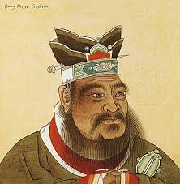
Facts
Confucius’s father died when he was only 3, it’s because his dad was a warrior.
Confucius's mother had no choice but to move since her husband died, but Confucius was sad but he knew that he had a long life ahead of him.
Confucius was born before Jesus.
Confucius was the first teacher in China and he was a philosopher.
Confucius
Facts
Confucius is from China and was born in Qufu.
Confucius started his career around 24 .
Confucius family was poor ever since his dad die and his mum was taking care of him.
Confucius real name is Kong Qiu.
Confucius had a wife and he was married to her when he was 19.

Slide 3
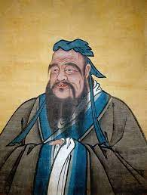
Confucius
Quotes
“It does not matter how slow you go as long as you don’t stop.”
“Virtue is not left to stand alone.”
“The object of a superior man is truth.”
“ When you have faults do not fear to abandon them.”
“ If you are the smartest in the room, that means your in the wrong room.”
“To see what is right and not to go it is want of courage, or of a principal.”

